Slide 1


Building a Sustainable Rural Workforce: Recruitment and Retention Strategies for Iowa State Agencies
Brenda Bartz, Vania Boyd, Amanda Ewing, Charlotte Richards, Marie Todey, and George Walton
3/2/2023
Notes:
GEORGE
Good morning, everyone. I’m George Walton. On behalf of my colleagues — Brenda, Vania, Amanda, Charlotte, and Marie—I am excited to introduce our project: Building a Sustainable Rural Workforce. Our team represents a cross-section of state service—from the DNR and DOT to Health and Human Services. While our daily roles differ, we share an urgent challenge: recruiting and retaining staff in our rural communities.
As you’ll hear today, we aren't just looking at a hiring problem; we are facing a demographic 'Retirement Cliff' where 39% of our state workforce is currently over the age of 55. Without an intentional strategy to build a homegrown talent pipeline, we aren't just losing staff—we are losing decades of institutional knowledge exactly where it is hardest to replace.
0:54

Slide 2
Rural Iowa is struggling to recruit and retain qualified candidates due to population decrease, aging talent pool, limited family resources and compensation constraints - all compounded by broader demographic trends and infrastructure limitations.
Notes:
GEORGE
As we outline here under our project focus, rural Iowa is actively struggling under the weight of shrinking populations, aging talent pools, and rigid compensation practices. We chose to build our project around this problem because when a rural state position sits vacant, public service breaks down.
To anchor our research, we looked at specific, high-touch positions where a physical presence is absolutely non-negotiable: Park Managers with the DNR and Child Protection Workers and Case Managers within HHS. We chose these roles precisely because they represent a core of state service. These aren't jobs that can be automated or optimized away by emerging technologies. If a child protection worker isn't in the field, a vulnerable family goes unserved. If a park manager isn't on-site, a state park can't safely operate. The core reason for this project is to move our state away from reactive, emergency hiring – and design a proactive strategy that treats our rural communities as a lifestyle advantage rather than a recruiting obstacle.
2:03

Slide 3
Project Focus - Investigate the “WHY” and “HOW” to Improve
Analyze rural Iowa current conflicts and restrictions
Focus Groups with Park Managers with the Iowa Department of Natural Resources
Focus Groups with Social Workers with Iowa Health and Human Services
Draft recruitment and retention recommendations for agencies.
Notes:
GEORGE
To tackle this, our project focus was built around investigating both the 'Why' and the 'How' behind this crisis. We knew that to build real solutions, we couldn't just look at high-level data; we had to understand the structural friction on the ground.
First, we analyzed the current conflicts and restrictions within rural Iowa, examining how statewide rules—like standard DAS benefit policies—inadvertently restrict our rural managers from competing with local private sectors.
Next, we went directly to the source. We conducted targeted focus groups with fifteen current staff—specifically Park Managers with the DNR and Social Workers with HHS. We chose these focus groups because these individuals are living this reality every day. They gave us the qualitative data spreadsheets could never capture—the real-world 'pain points' of finding affordable rural housing and navigating rigid fleet vehicle policies, for example.
Finally, we used these insights to draft a set of comprehensive recruitment and retention recommendations – highlighting ones that are specifically tailored for these agencies, as well as those that are more broadly applicable. Our goal was to create an actionable roadmap that bridges the gap between state policy and rural reality.
Now that you understand how we gathered our research, I’m going to turn it over to Vania, who will walk you through the stark demographic trends and population declines that make these recommendations so vital.
HHS and DNR are constrained by DAS policies that limit the ability to enhance benefits or offer additional incentives targeted at rural recruitment. Furthermore, agencies are unable to provide housing or relocation reimbursement due to budgetary and policy restrictions, which may further hinder their ability to attract candidates to rural positions.
3:30

Slide 4
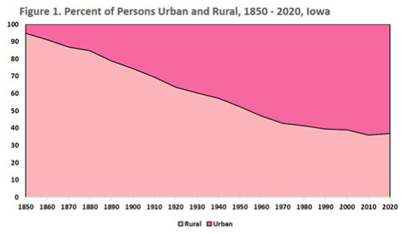
Rural Iowa Population Decreasing
2020 Census shows:
  Urban pop. 2 million (⅔)
  Rural pop. 1.2 million (⅓)
Iowans are migrating:
  Economic restructuring
  Lack of quality jobs
  Limited childcare
  Lack of nearby services
2020 Census shows:
  Urban pop. 2 million (⅔)
  Rural pop. 1.2 million (⅓)
Notes:
VANIA
Through our research on demographic trends, we found Iowa’s rural community population has drastically decreased since the 1950’s. The graph on your screen is a visual representation of the 2020 Decennial Censuses report showcasing the changes between rural and urban population from 1850 (4 years after Iowa became a state) to 2020. The light pink on the bottom left of the graph represents rural communities and the dark pink represents urban communities.
During the 1950 and 1960 Decennial Censuses, Iowa was about half urban and half rural. Since that time - Iowa has become significantly more urban. In 2020, the census showed Iowa’s urban population of 2 million 2/3 and a rural population of 1.2 million or 1/3.
Why are Iowans leaving rural Iowa? Through our research, we found Iowans are migrating due to economic restructuring, lack of quality jobs, limited childcare and lack of nearby services.
4:41

Slide 5
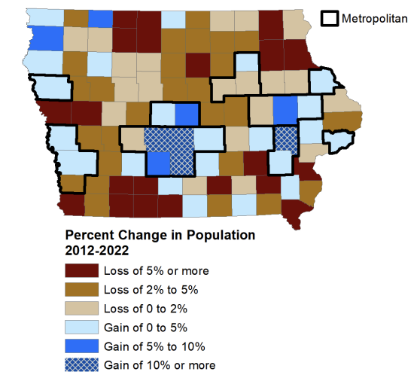
Demographic Trends
Iowa State University Extension and Outreach conducted the demographic trends over the last 20 years:
Des Moines Metro growing fast with
  Dallas County’s population booming by 48%,
  Warren and Polk counties at 16.5% and 11.6%.
Data shows a decline in population the northern, west central, and southern Iowa counties such as
  Jefferson County (Fairfield) decreased by 12.4%,
  Adams (Corning) and Fremont (Sidney) counties fell by 8.8%
Notes:
VANIA
In 2024, Iowa State University Extension and Outreach conducted demographic trends for the last 20 years. The graph is a visual of population changes by counties from 2012 to 2022. The dark brown color represents a loss of population by 5% or more and the blue checkered color represents a gain of 10% more.
For example - The Des Moines Metro saw fast growth with Dallas County’s population booming by 48% (this includes towns such as Adel and Waukee), followed by Warren and Polk counties at 16.5% and 11.6% (this includes towns such as Ankeny and Indianola).
By contrast, the data shows a decline in the northern, west central, and southern counties of Iowa such as Jefferson County (Fairfield) which decreased by 12.4%, Adams (Corning) and Fremont (Sidney) counties fell by 8.8%
The report summary confirmed that most people leaving rural areas are youth under 25 years of age, and experienced workers age 45 – 64.
5:58

Slide 6
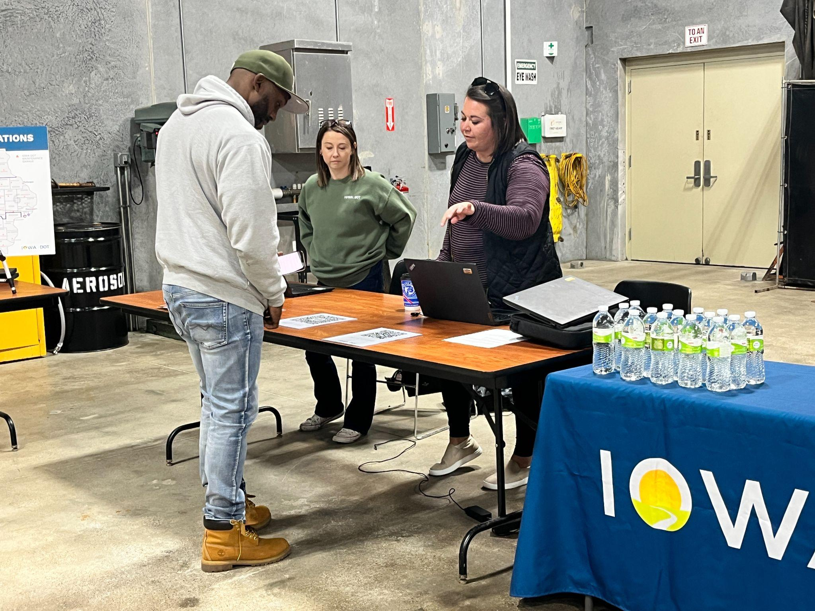
Impacts on State Agencies
Costs to fill positions multiple times
Increase cost on overtime/travel reimbursements
Higher workload on current staff/burnout
Reduced quality of services to the public
Lower quality of work
Loss of community connections
Iowa DOT Winter Operations Hiring Event
Notes:
AMANDA
“When state agencies struggle to recruit and retain employees in rural areas, the impact extends far beyond an unfilled position. It creates operational, financial, and service-related challenges that affect the entire organization and the communities we serve.
First, there are significant costs associated with filling positions multiple times. Rural positions often remain vacant longer, require repeated job postings, and demand additional time and effort from hiring teams. This increases recruitment costs and delays productivity.
Second, agencies experience increased overtime and travel expenses. Existing staff are frequently required to travel longer distances or work additional hours to cover vacant positions. While this helps maintain operations in the short term, it is not a sustainable long-term solution.
These staffing shortages also place a heavier workload on current employees. Team members are often expected to absorb additional responsibilities, which can lead to stress, fatigue, and ultimately burnout. Over time, this impacts morale, engagement, and retention among existing staff.
As vacancies continue, the quality of public services can also decline. Longer response times, reduced program availability, and limited staff capacity can directly affect the level of service provided to citizens and local communities.
In addition, when positions remain unfilled for extended periods, the quality and consistency of work may decrease. Employees covering multiple roles may not have the time or specialized expertise needed to maintain the same level of effectiveness and attention to detail.
Finally, one of the most significant impacts is the loss of connection with the community. Rural employees often serve as trusted local contacts who understand the unique needs, relationships, and culture of the communities they support. Frequent turnover or prolonged vacancies can weaken those relationships and reduce public trust and engagement.
Overall, rural recruitment challenges are not simply a hiring issue — they affect workforce sustainability, employee wellbeing, organizational efficiency, and the quality of services delivered to the public.”
8:27

Slide 7


Why Focus Groups
Park Managers | Social Workers
Capture rich, qualitative insights
Group interaction, discussion
Probe deeper into unexpected topics
Allow participants to explain diverse perspectives
More context
Notes:
AMANDA
Initially, we explored the possibility of using quantitative data alone to analyze turnover and applicant flow trends. However, we encountered limitations within the HHS data collection systems. Many positions are classified as urban-based, even though they require substantial travel to rural service areas. Because of this, it became difficult to isolate and accurately measure recruitment and retention trends that are specific to rural service delivery.
As a result, we decided to use focus groups as a primary method of gathering information. We chose focus groups because they allow us to gain deeper, more detailed insights that quantitative data alone often cannot provide.
One of the biggest strengths of focus groups is the ability to capture rich qualitative feedback. Instead of selecting answers from a survey, participants can explain their experiences, perspectives, and challenges in their own words. This helps uncover motivations, concerns, and barriers that may not appear in traditional data sets.
Focus groups also create opportunities for interaction and discussion among participants. Individuals can build on each other’s comments, validate shared experiences, or offer different viewpoints. This group dynamic often leads to more thoughtful and comprehensive insights than individual interviews alone.
Another reason we selected focus groups was flexibility. During the discussion, we were able to ask follow-up questions, explore unexpected themes, and dig deeper into issues as they emerged. This made focus groups especially valuable for exploratory research and understanding the complexities behind rural recruitment and retention challenges.
Focus groups were also an efficient way to gather multiple perspectives within a limited timeframe. Rather than conducting numerous separate interviews, we could engage several stakeholders at once while still collecting meaningful, detailed information.
Finally, focus groups helped provide context behind the quantitative trends we were seeing. While data can show that turnover exists or that vacancies are difficult to fill, focus groups help explain why those challenges are happening and how they are affecting employees and agencies in practice.
At the same time, we recognize that focus groups do have limitations. They are not intended to provide statistically representative data, and group dynamics can sometimes influence responses. Because of this, we viewed focus groups as a complement to existing data sources rather than a replacement for them.“
For this research, we chose to focus on specific classifications that both agencies identified as having significant recruitment and retention challenges in rural areas. Within the Iowa Department of Natural Resources, we focused on Park Manager positions, and within Iowa Health and Human Services, we focused on Social Worker classifications located in rural communities. For clarification, the social worker classifications included both Child Protection Workers and Case Manager Specialists.
Now i am going to turn it over to marie to discuss our focus group findings.
11:38

Slide 8
Focus Group Discussions
Park Manager
Pros | Cons
Purpose / passion for work | Small community / no connections
Variability / flexibility in work | Housing availability
Connections | Job for spouse
 | Family needs - childcare
 | Safety
Notes:
MARIE
As Amanda mentioned, we looked at two positions: Park Managers and Social Workers. Brenda will talk about Social Workers in the next slide.
Chose Park Manager = 70% of turnover in this classification occurs in rural counties or state parks, and Park Managers in rural areas represent 24.50% of the Parks Bureau workforce.
Pros of being a park manager in a rural area:
People have a passion for the work they’re doing, and they have variability in the daily work that they do, so it’s always interesting.
They can also form tight connections with the community.
Cons of being a park manager in a rural area:
It can be difficult to form initial connections with a small, tight-knit community.
There may not be a lot of housing available in the community, so managers may have to live in nearby cities.
Note: park managers are required to live within 30 road miles of the park they work in, so this may make it more challenging.
In addition, the DNR previously provided housing to park managers; however it was consistently in disrepair and required additional resources, so there was a higher up decision that it would no longer be offered.
It’s not just the park manager job; their spouse also needs a job, and adequate childcare needs to be available.
There can be safety issues. We had one woman mention she didn’t always feel comfortable with people knowing where she lived and recognizing her outside of work.
Other things we found in the focus groups:
Candidates are more willing to move and can be flexible in finding a job. Some of the time they just wanted a park manager job and would take whichever one opened up.
Benefits, especially IPERS, played a huge role in attracting and retaining people. (One park manager mentioned she took a huge pay cut for the park manager position, but with IPERS, she’s more likely to stay long term.)
Now Brenda can discuss findings from social worker focus groups.
Note: HHS and DNR are constrained by DAS policies that limit the ability to enhance benefits or offer additional incentives targeted at rural recruitment. Furthermore, agencies are unable to provide housing or relocation reimbursement due to budgetary and policy restrictions, which may further hinder their ability to attract candidates to rural positions.
13:35

Slide 9
Focus Group Discussions
Social Worker
Pros | Cons
Community connections | Personal vehicle wear
Family driven | Travel time
Variability / flexibility in work | Safety
Higher retention rates
Safety
Notes:
BRENDA
HHS staff specifically spoke about the relationships they build in the communities where they work. This brought a sense of belonging as well and heightened awareness of support and services to the families they serve. Staff identified their work in the rural area led to building relationships that keeps them there. The community relationships built with school personnel, medical providers, mental health providers, law enforcement, and businesses enhances the work HHS does with families. They have connections they can lean on when needed for better outcomes for families.
HHS staff identified their safety and access to law enforcement being more consistent in the rural areas where they know officers by name and location. This relationship also helps them in supporting the families and building relationships between local law enforcement and families. Staff did anecdotally note that recruiting from rural areas tends to relate to higher retention. Several noted they chose to work in the rural areas because that is their home town area. By living rurally where they work they have their support system for their own family needs. This shows the need for recruiting in the local areas where vacancies are.
When considering the work in rural areas HHS staff noted travel time and wear and tear on their vehicles as areas of concern. One noted they can spend over an hour (one way) in their car travelling to meet with a family. When assessing the safety of children there are times that workers will travel that distance and not find anyone home. This takes a lot of time out of the work day. Staff noted they have state vehicles available to them, but they are parked at the full time offices which can be a long distance from the rural area where staff are working. Staff provided there would be times they needed to drive the opposite direction of a family in order to get to the full time office to use a state car. They then would use the state car travelling back to the rural area they were just at. Wear and tear on their personal cars includes traveling many miles, traveling rural/gravel roads, and general maintenance. Not to mention current gas costs.
Note: HHS and DNR are constrained by DAS policies that limit the ability to enhance benefits or offer additional incentives targeted at rural recruitment. Furthermore, agencies are unable to provide housing or relocation reimbursement due to budgetary and policy restrictions, which may further hinder their ability to attract candidates to rural positions
16:00

Slide 10
Focus Group - Commonalities
Pros
State benefits
  IPERS
  40 hrs/week
  Flexible schedules
Benefits of rural areas
  Sense of community
  Cheaper cost of living
  Outdoor activities
  Distance to family
Smaller office = more variability in the day-to-day work
Cons
Daycare
Housing
  Especially initial search
Lower pay than private sector
Managers see better long term success in finding candidates who have already lived in smaller communities and are accustomed to the lifestyle.
Notes:
CHARLOTTE
There were many things that both DNR and HHS staff talked about that helped draw them to state work in rural areas and keep them there.
One thing that most people in the focus groups brought up was the good benefits the state offers, naming IPERS, insurance, flexible scheduling, and an emphasis on only working 40 hours per week as big draws over private sector jobs in their rural areas.
Another was the sense of community rural areas tends to bring, plus a cheaper cost of living, and a slower pace of life (while still offering things to do). There were a couple individuals who also said they were originally from a rural area and that they enjoyed staying closer to family in that area.
Additionally, staff appreciated the variability in the day-to-day work of the job with a smaller office staff.
On the negative side, individuals with children spoke about the difficulty in finding affordable and stable daycare in their rural area. This went in hand with the difficulties in finding affordable housing, especially initially upon moving to a new rural area. For individuals looking to rent, they spoke of difficulties of finding what properties were available before they moved to the area as most rental listings were not available online. One mentioned that once they had found temporary housing in the area they were able to find better long term housing through word of mouth or something like flyers at a local store. This was a big hurdle for them to overcome initially and added unneeded stress to their life.
Finally, many mentioned that the pay the state offered did not compare with the private sector, and that the state benefits only helped balance out things in the long term, which was not helpful when trying to establish themselves in a rural area if they were moving for a state job.
In one of our interviews with a hiring manager, they pointed out something that was corroborated by our focus groups: that finding candidates who have already lived in smaller communities and are accustomed to the rural lifestyle lead to higher retention long term.
And now Marie will walk us through the first section of our recommendations that came out of our research.

Slide 11
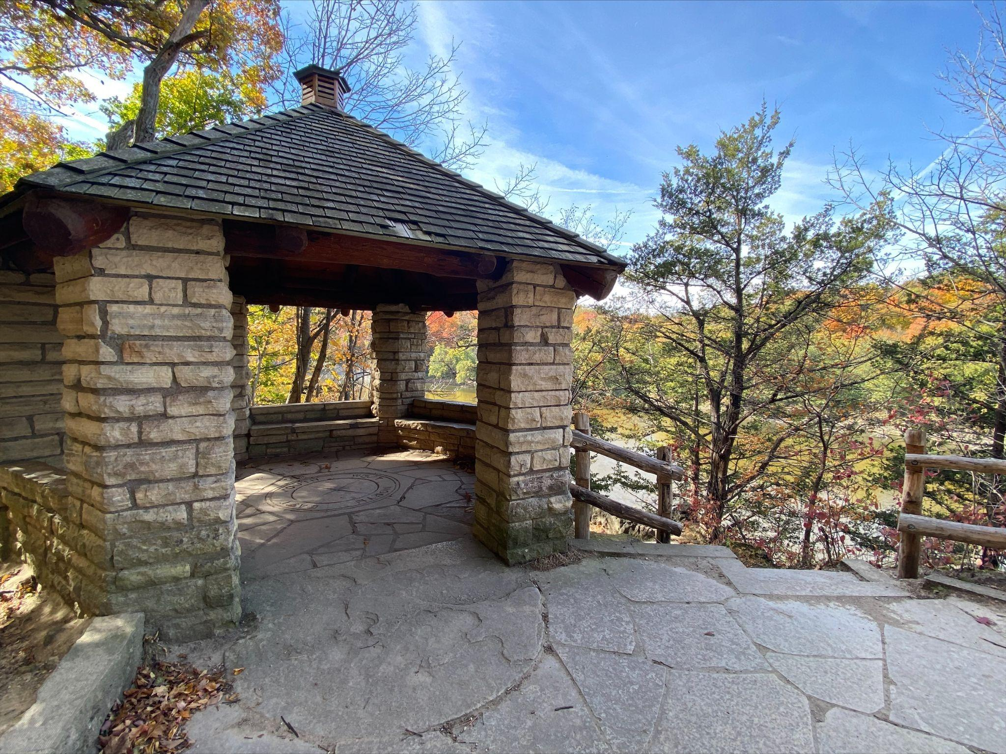
Recommendations for DNR
Target environmentally passionate people:
  Hunters, anglers, environmentalists, etc.
Job shadowing
  Administrative
Field trips/volunteer programs
Notes:
MARIE
Going to go over recommendations that are specific to DNR. Brenda will cover HHS-specific ones, and then Charlotte will cover recommendations for the State of Iowa as a whole.
Focus group attendees suggested targeting people such as hunters, anglers, environmentalists, etc., people who already have a passion for the natural resources work. You can’t force someone to develop passion for something, so you have to find people who already have a drive to work outside in the environment.
Another option would structure a Park Manager job shadow to emphasize administrative oversight, rather than physical operations. There are federal labor restrictions on workers under 18 years of age (limits on hours, equipment they can use, physical labor they can do, etc.), and these positions very physically labor demanding. So focusing more on administration would sidestep that.
The Department could also explore organized field trips and expanded volunteer programs to help foster an interest in natural resources without formally employing people.
Brenda will now go over HHS-specific recommendations.
19:02

Slide 12
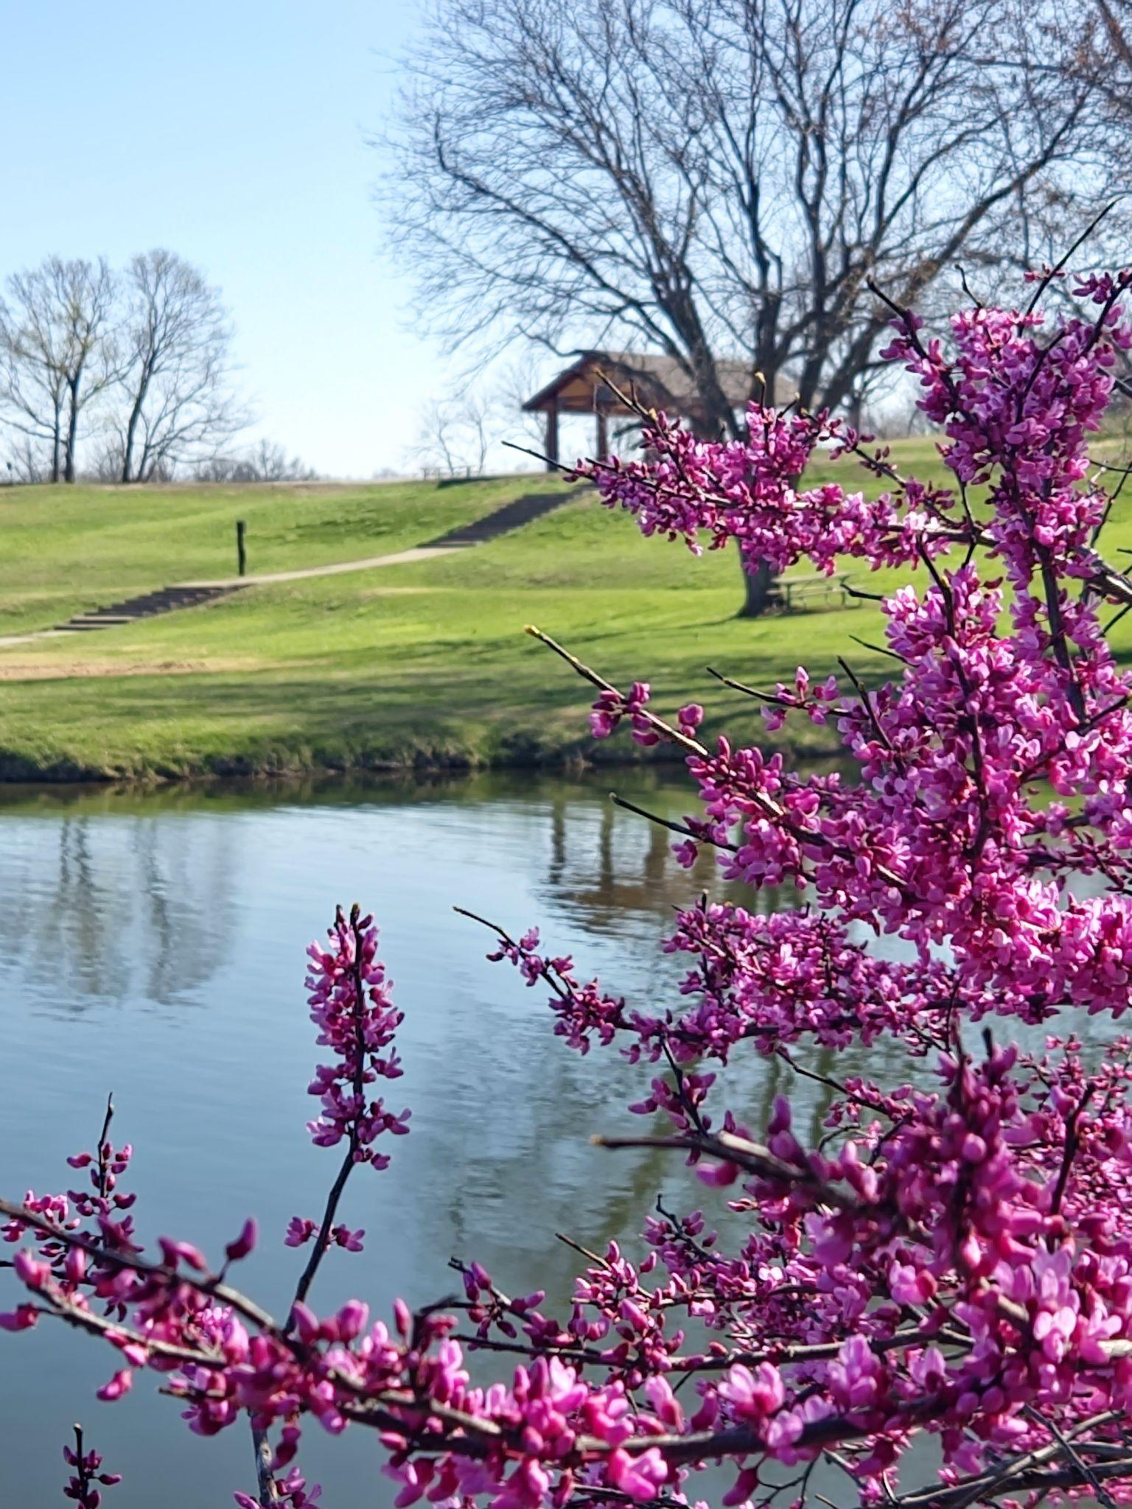
Recommendations for HHS
Paid internships
Updated vehicles policy
  Mileage/per diem policies
Emphasis on community involvement
  Leads to an increase in safety
Clearer job postings
  Full time urban office covering rural areas
Expand “community liaison” position
Notes:
BRENDA
Focus groups for HHS pinpointed Social Workers in vc cthe field both Child Protection Workers and Case Managers. From our focus groups, research and discussions the following recommendations are made:
Paid internships. Currently, HHS has unpaid internships. By enhancing this paid internships it is likely there would be a larger group of applicants available when a posting is made. The interns with experience would need less training and be more prepared for the difficult job.
Updated vehicle policy or mileage/per diem. There are state agencies that where staff have vehicles available to them at their home. Another recommendation would be to put state vehicles at less than full time offices where case loads are higher and staff can have easier access to them versus driving to a full time office out of the way. Another recommendation would be to allow mileage to be assessed started at an approved remote work site (home office). Currently staff subtract commuter miles to their miles driven that day and that is what is reimbursed. When staff are working remote that is their office and where mileage should begin. This would be more efficient for staff time as well.
When recruiting in a rural there should be an emphasis on the community where the work will be done. This includes putting information in the posting about the location (not just the full time office domicile) as well as advertising more locally. There needs to be an emphasis on community relationships and drawing from that as a benefit and support to a new staff in the rural area.
Using the community liaison as a support to rural staff. The turn over for field staff (especially in rural areas) happens regularly. The community liaison is someone who can manage community supports and engage new and on-going social workers in the rural community
20:30

Slide 13
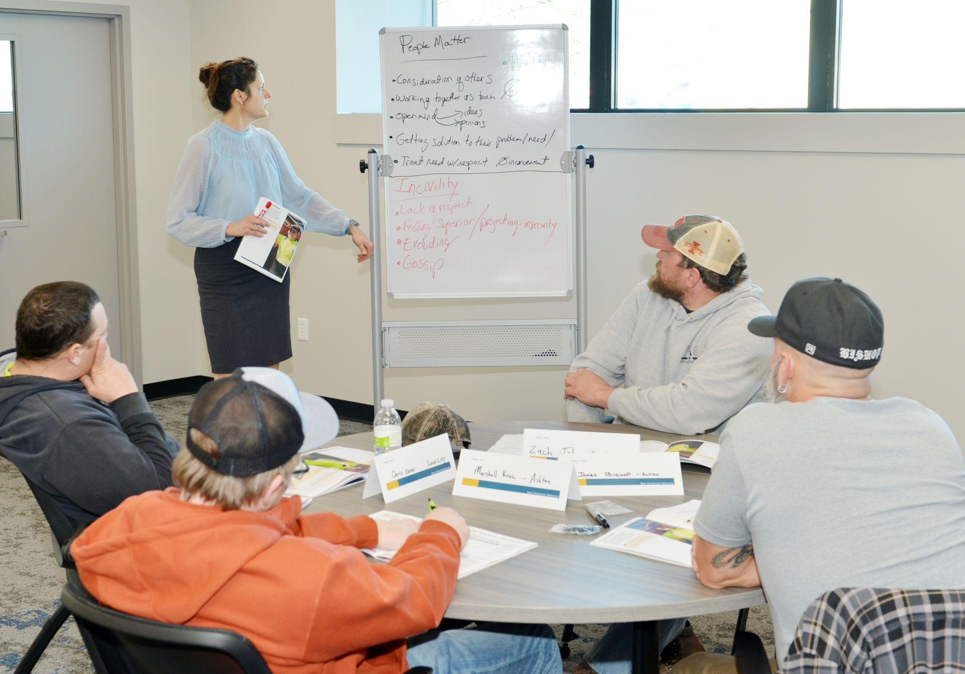
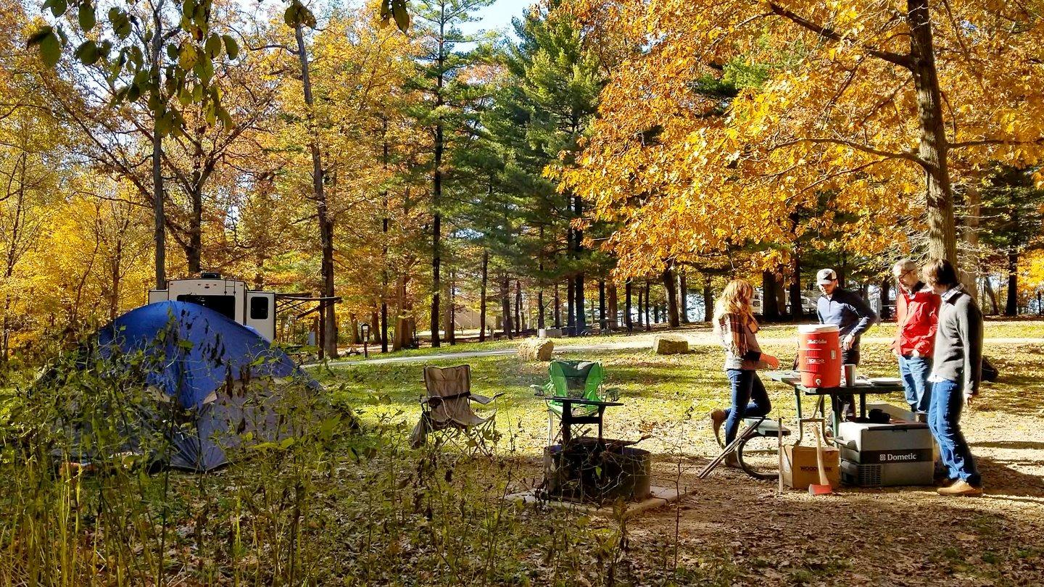
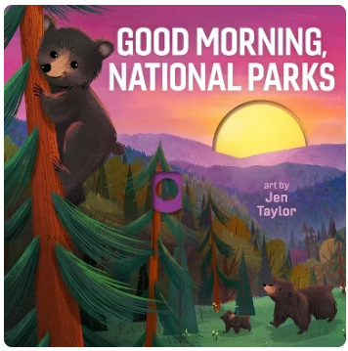
Recommendations - State of Iowa
DOGE report
Adjust starting base pay
Local focus
Build up rural communities
Outside the box ideas
Notes:
CHARLOTTE
Sadly, there is no one perfect solution to this issue.
In researching this project, we felt it was important to spend time analyzing the Iowa Dept of Government Efficiency report that Governor Reynolds commissioned in 2025, as many of the same issues we identified were also identified in this report, and some of the same recommendations we laid out were laid out in greater detail in this report. The report emphasized apprenticeships and job shadowing as a way to build up the state workforce, which may be harder to adapt for specific positions like social workers which deal with confidential information on a daily basis. However, we recommend that agencies take a hard look on how to implement internships and job shadowing with more positions to help grow the rural workforce from a younger age.
We also recommend that the state look at adjusting starting salaries for most positions, and making them more comparable to private sector positions as state benefits seem to be diminishing in attractiveness to new employees.
Overall, we believe that there needs to be an emphasis to “focus on local” or to direct more time and energy towards the roots of the issue of why Iowa’s rural areas are decreasing in population - not to necessarily drive individuals to rural areas but to make those areas a desirable place for rural individuals to stay. We recommend that the state of Iowa place a larger emphasis on funding rural schools, daycare centers, affordable housing, and healthcare to build up the infrastructure.
Additionally, we encourage state leaders to think more outside of the box and holistically about this issue. One outside the box idea we kept coming back to in our project group discussions was pushing for more children’s books to be written about jobs in these harder to retain positions… our thought was to reach kids in a positive way at an early age to introduce them to some of these careers, and this would also help with education and literacy. We found lots of “park ranger” focused childrens books, but not “park manager,” and similarly there are lots of essential worker focused kids books - like nurse, firefighter, police officer, etc, but not social worker. Introducing these career paths early would hopefully be a low cost, high reward investment in the long term. Another outside the box idea was to make a more lenient vehicle policy for more agencies, as referenced earlier, as well as looking into temporary housing or housing allowances for new state workers.
Another outside the box proposal is that the state invest in agro/eco-tourism to insulate the agriculture economy in Iowa. We have many beautiful natural areas in Iowa, which coincidentally also tend to be rural, so building up tourism in places like the Driftless region or the Loess Hills would create a base for the rest of the aforementioned recommendations.
Finally, a part of CPM that all of us in our group really found meaningful were the connections and the stories from individuals from other agencies. We will be taking this sense of connection into our future work. So we would recommend that workers from rural communities and counties meet together on a semi-regular basis to build connections for new state workers, and help workers in all stages of their careers to share resources.
23:14

Slide 14
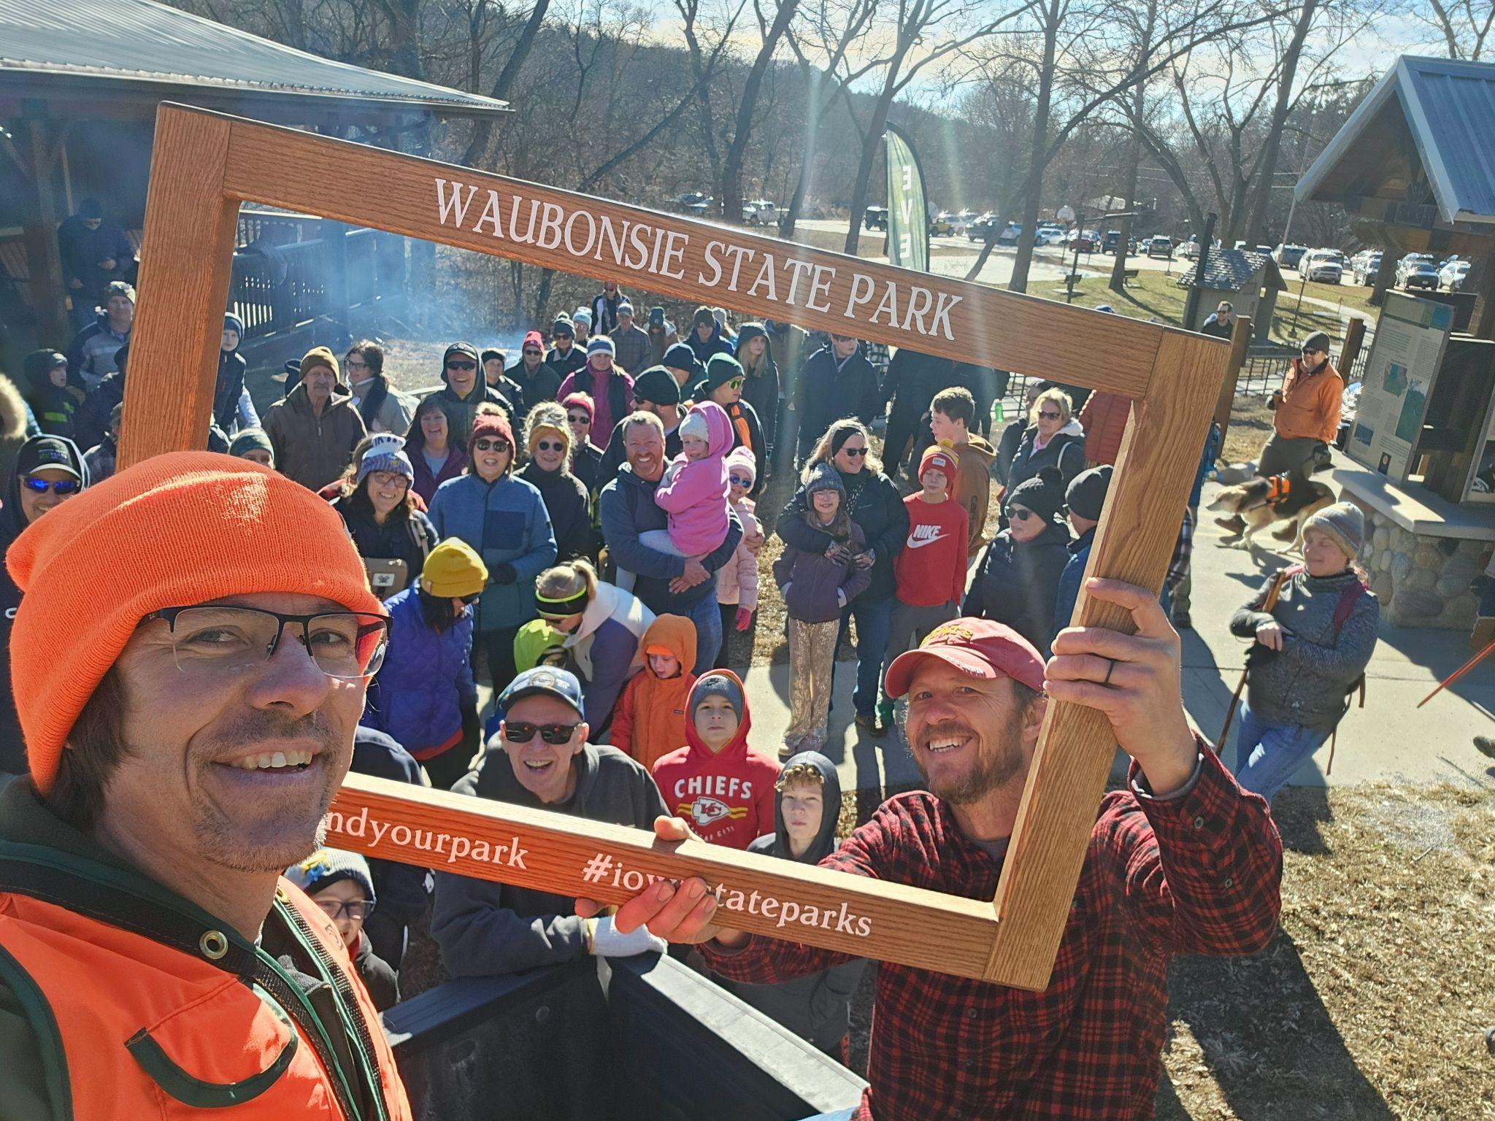
Questions?
Notes:
Total time: 23:52

